Slide 1


Team Details
  Team name: Multimodal Studio
  Team leader name: M Sai Teja
  Problem statement: A teacher still rebuilds a chapter as slides, then records it. The voice and the picture do not move together, so students get a page read aloud.

Slide 2

Note: Please download this template to make your edits and submit the final version.
To download, go to File > Download > Microsoft PowerPoint (.PPTX). Kindly refrain from sending edit requests.

Slide 3
Brief about the idea
M Sai Teja leads and built this.
You drop a chapter or a set of notes. You get a short video a class can replay. Gemini writes the slides. Gemini 3.8 Live speaks them.
The highlight moves with the sentence, so it feels like someone explaining, not a page being read out.

Slide 4
Opportunities
How different is it from any of the other existing ideas?
How will it be able to solve the problem?
USP of the proposed solution
Different from what exists
Slide tools stop at the deck. Read-aloud tools ignore the picture. Neither gives a class a video.
How it solves the problem
One file goes in. A video comes out. The teacher does not record, and does not line the voice up by hand.
USP
The voice and the highlight stay in time. That is the part a normal deck and a normal voiceover both miss.

Slide 5
List of features offered by the solution
Drop a PDF. Get a video for YouTube or a Short.
Say the age. The wording changes for that class.
Gemini 3.8 Live speaks it, and the highlight follows the voice.

Slide 6
Process flow diagram or Use-case diagram
Two ways in. You drop something, or the admin queue picks a paper overnight. After that it is one path.
Drop a file
Read it
Write slides
Speak them
Film frames
MP4
Upload a chapter, or let the queue pick a paper. Then one path to the video.

Slide 7
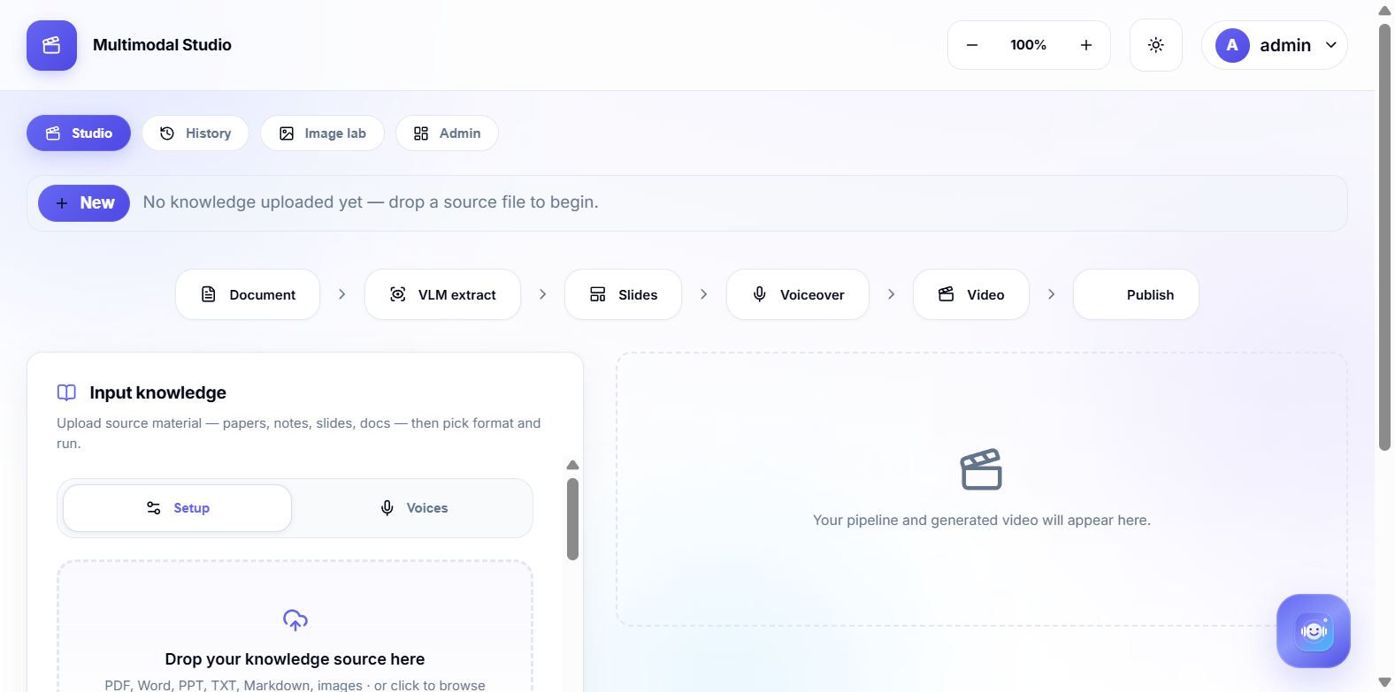
Wireframes/Mock diagrams of the proposed solution (optional)
The Studio page
File on the left. Format and voice beside it. Run, then play the video on the same page.

Slide 8
Architecture diagram of the proposed solution
Studio page → Cloud Run → Gemini → MP4
Gemini 3.8 Flash reads the file and writes the slides. Gemini 3.8 Live speaks them. Chrome films the frames. FFmpeg joins the sound.
Each job is copied to Firestore. This pitch page is on Firebase Hosting.

Slide 9
Technologies to be used in the solution
Gemini 3.8 Flash writes the slides. Gemini 4 Argon is there when the chapter is dense.
Gemini 3.8 Live is the voice.
Cloud Run hosts the app. Firestore keeps each job. Firebase Hosting serves this pitch.

Slide 10
Estimated implementation cost (optional)
No GPU. A normal video on Gemini Flash is a few rupees.
Cloud Run and Firestore stay in the free tier for review traffic.

Slide 11
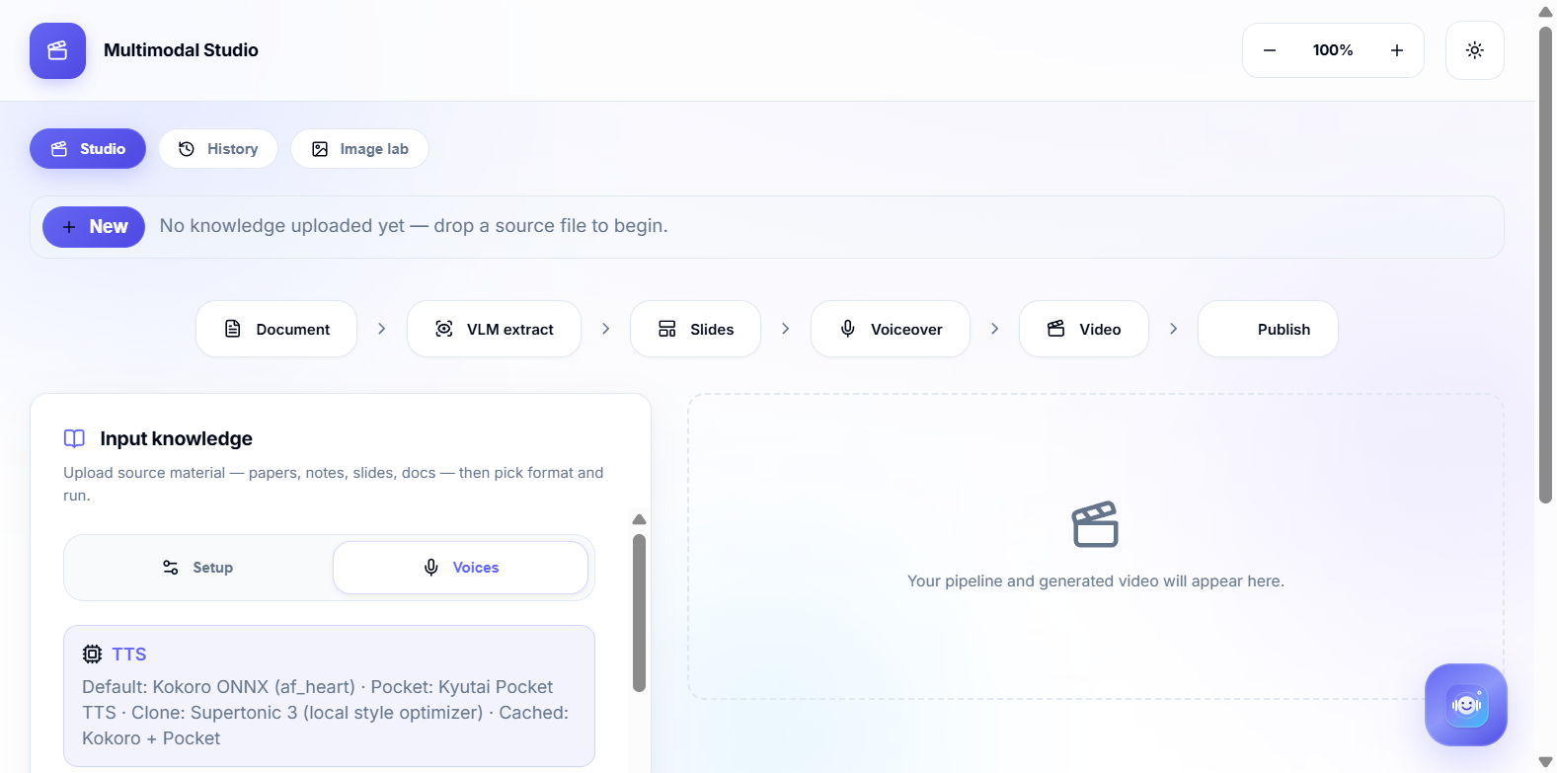
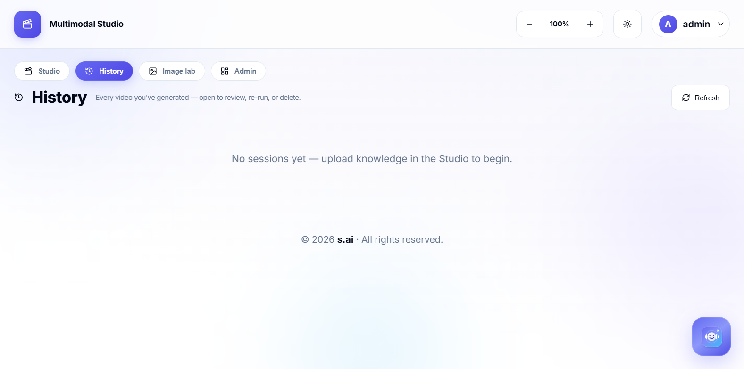
Snapshots of the prototype
These are screens from the app we run, not drawings of a future one.
Studio. Drop the file and run.
Pick a voice before you run.
Past runs stay here.

Slide 12
Prototype Performance report/Benchmarking
A chapter-length run finishes. Filming the slides is the slow step.
We have not published a benchmark table. Each job does record how long its own steps took.

Slide 13
Additional Details/Future Development (if any)
Next: handwritten teaching slides, and Manim-style motion when the chapter has a formula.
After that, a few YouTuber looks you can pick, or make your own.

Slide 14
Provide links to your:
GitHub Public Repository
Demo Video Link (3 Minutes)
Final Product Link
GitHub: https://github.com/saitej123/Gemini-Multimodal-Studio
Demo video: still to record (3 to 4 minutes, one real file).
Product: https://multimodal-studio-469528918286.us-central1.run.app

Slide 16


